Slide 1
Observability now!
Open Telemetry is here and we should know about it

Slide 2

Justin Castilla
Senior Developer Advocate
justin.castilla@elastic.co | @CastillaCodes | @justincastilla.bsky.social

Slide 3
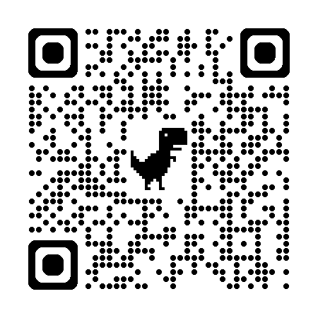
https://www.github.com/JustinCastilla/
Introduction-to-OpenTelemetry-with-JS

Slide 4
Agenda
Observability basics
What is OpenTelemetry and why use it
Nodejs instrumentation
The state of OpenTelemetry

Slide 5
I had attempted to find a short primer on starting with OpenTelemetry with Javascript but couldn’t find much more than a demo application.
https://opentelemetry.io/docs/languages/js/getting-started/nodejs/

Slide 6
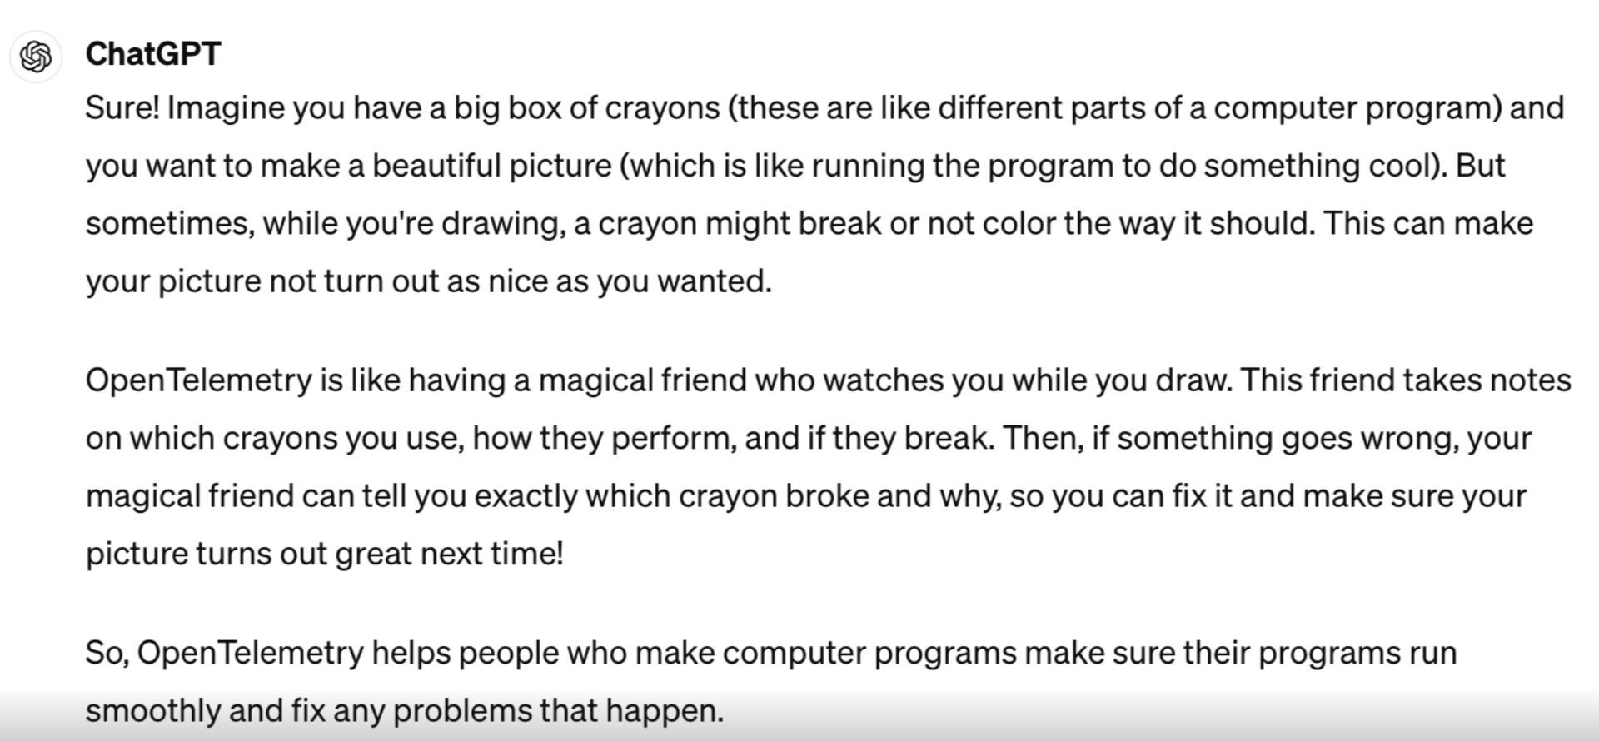
Notes:
I’m hoping you walk away from this talk with a strong understanding of what Open Telemetry is and how to get started integrating it into your applications.

Slide 7
Observability fundamentals

Slide 8
Observability helps you determine what's happening inside your system by analyzing the data it outputs
Notes:
Observability is the understanding of what is really happening to a system
It’s about the who what where when why of your application’s internal travel, and not just state you are in at the moment

Slide 9
The external outputs of a system—such as error messages, system logs, and performance metrics—act as hints that offer insights into the internal state of the system.
Notes:
By studying these outputs, you can gauge the health of the system.
Therefore we can identify any discrepancies that might indicate underlying problems.

Slide 10
What isn’t operating as expected
Notes:
This could include anomalies in performance metrics, errors logged, or unexpected outputs.

Slide 11
Beyond detecting problems
Notes:
Observability isn't just about detecting problems; it's also about understanding who is impacted by these issues.
This involves analyzing how failures affect end-users and other dependent services within the system.
Knowing the impact helps prioritize fixes based on their urgency and potential business impact.
It provides the necessary insights to diagnose and fix issues within the system.

Slide 12
Concept
Observability Agent

Slide 13
An observability agent is a software component or tool that collects, processes, and sends telemetry data from an application to an observability platform for analysis.

Slide 14
Concept
Observability Platform

Slide 15
An observability platform is a tool that collects and analyzes telemetry data from various sources to help understand the performance, health, and behavior of an application.

Slide 16
So what is Telemetry Data?

Slide 17
Logs
Logs are records of events in a system, documenting operations, errors, and activities to aid in troubleshooting, monitoring, and compliance.
Notes:
Stuff you print out
A log was for most of us our first program
Anything that can have a timestamp

Slide 18
Metrics
Metrics are quantitative measurements that track the performance and health of a system
Notes:
Aggregation
Numbers
Latency
Traffic count
Time on Page

Slide 19
Traces
Traces track the path and interactions of a request through a system.
Notes:
Events that have a start and a finish
Tells the story of the quest

Slide 20
Announced In early 2019, the OpenTelemetry project was announced as a merger of two existing open source projects: OpenTracing and
OpenCensus.
What is OpenTelemetry (OTel)?
Notes:
Announced In early 2019, the OpenTelemetry project was announced as a merger of two existing open source projects:
OpenTracing and OpenCensus.
Was all about tracing headers
W3C trace context wire protocol

Slide 21
OpenTelemetry (OTel) is an observability framework that is open source and vendor neutral, designed to work with any backend system.
It provides standardized APIs, libraries, and tools to collect telemetry data.
Notes:
The language everyone is using - Tom Eastman

Slide 22
Why?
Notes:
It’s easy to start using it

Slide 23

Logs alone are simply not enough sometimes

Slide 24
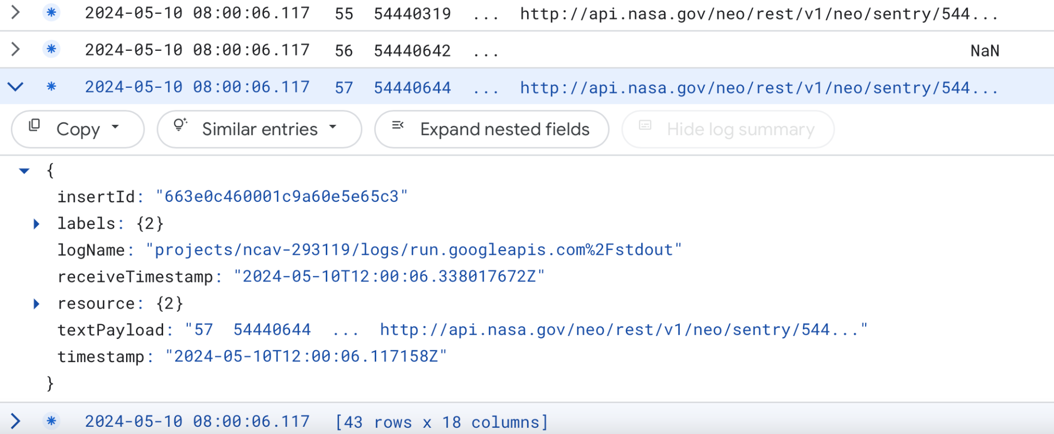
Um, what?

Slide 25
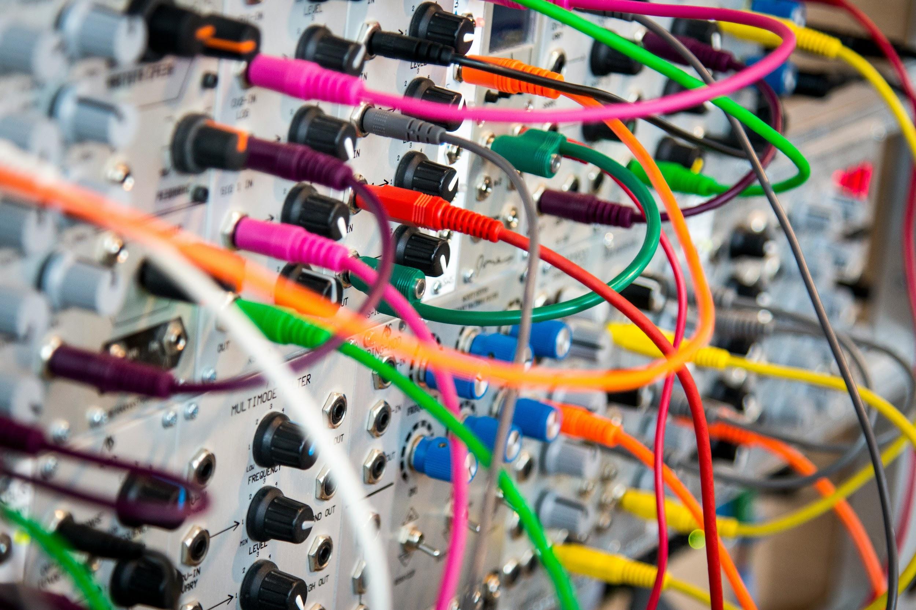
Notes:
We work with complex interconnected systems - lots of microservices
distributed systems and finding the root cause of issues and errors are painful.
Hard to optimize. Finding issues can be hard.
Open Telemetry enables a comprehensive view across the entire system, not just isolated parts.
It allows teams to understand the state of their system as a whole, monitoring everything from individual components to complete services.

Slide 26

Future proof
Notes:
FogBugz in 2011
Traditionally, many monitoring tools were vendor-specific, limiting their use to certain environments or technologies.
However, the trend is shifting towards more open, vendor-agnostic tools that offer greater flexibility and compatibility across different systems. -
The idea is as your shift towards new and different tools you will be able to monitor them in a comprehensive and robust manner.

Slide 27
Traces: Digging Deeper
Spans within Traces? What?!?!
Notes:
Trace - family
Span - one person in the family

Slide 28
Spans are the building blocks of traces. They include the following information:
Name
Parent span ID (empty for root spans)

Slide 29
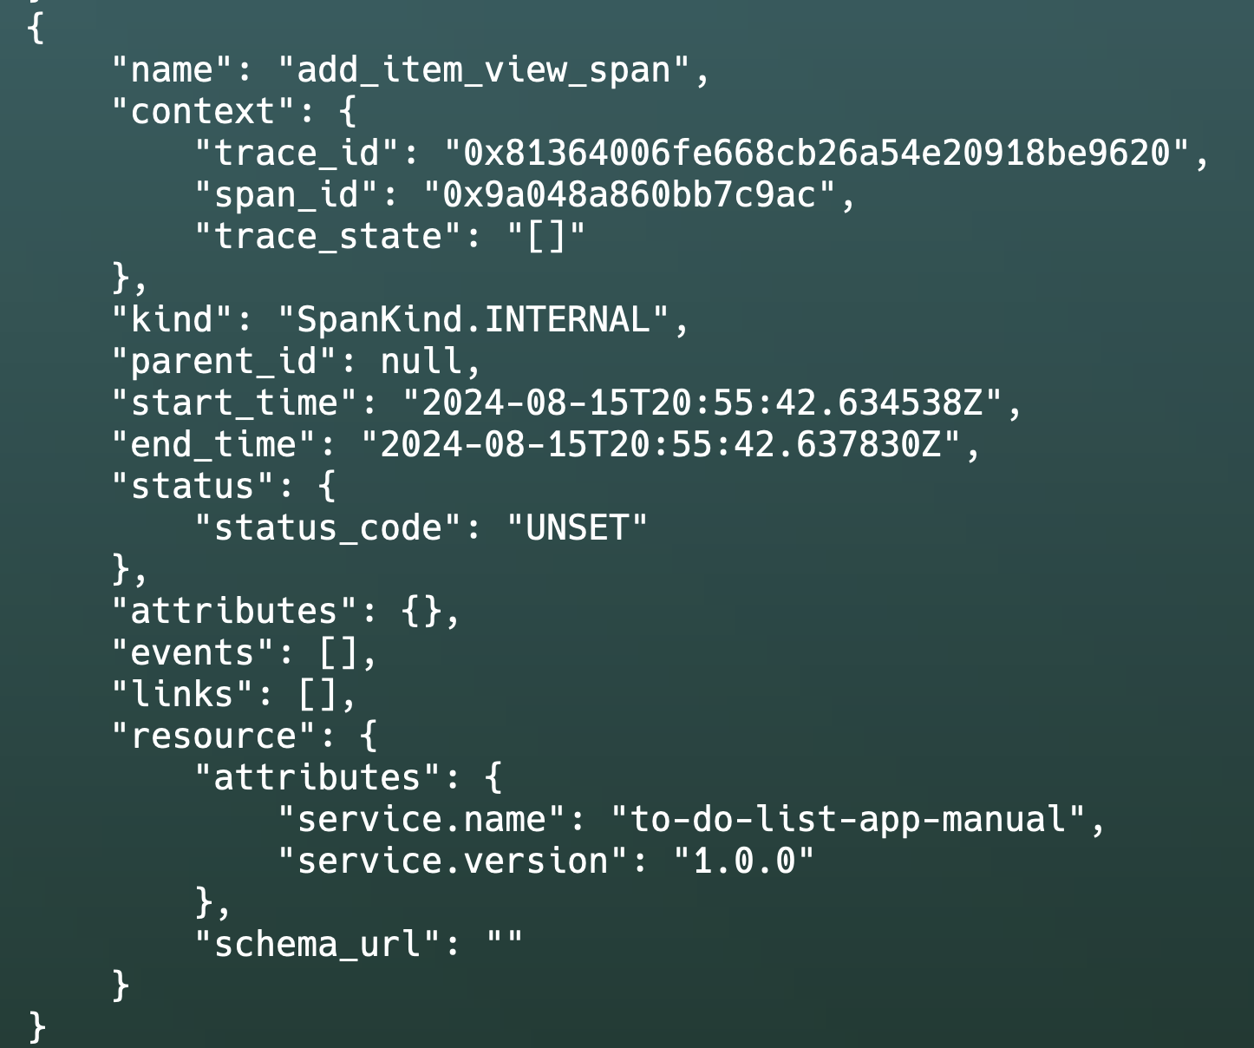
OHHH!
A span in the wild!

Slide 30


A trace is a journey, a span is a leg of that journey. A trace is a quest, a span is a subquest.
A trace is a novel, a span is a chapter.

Slide 31
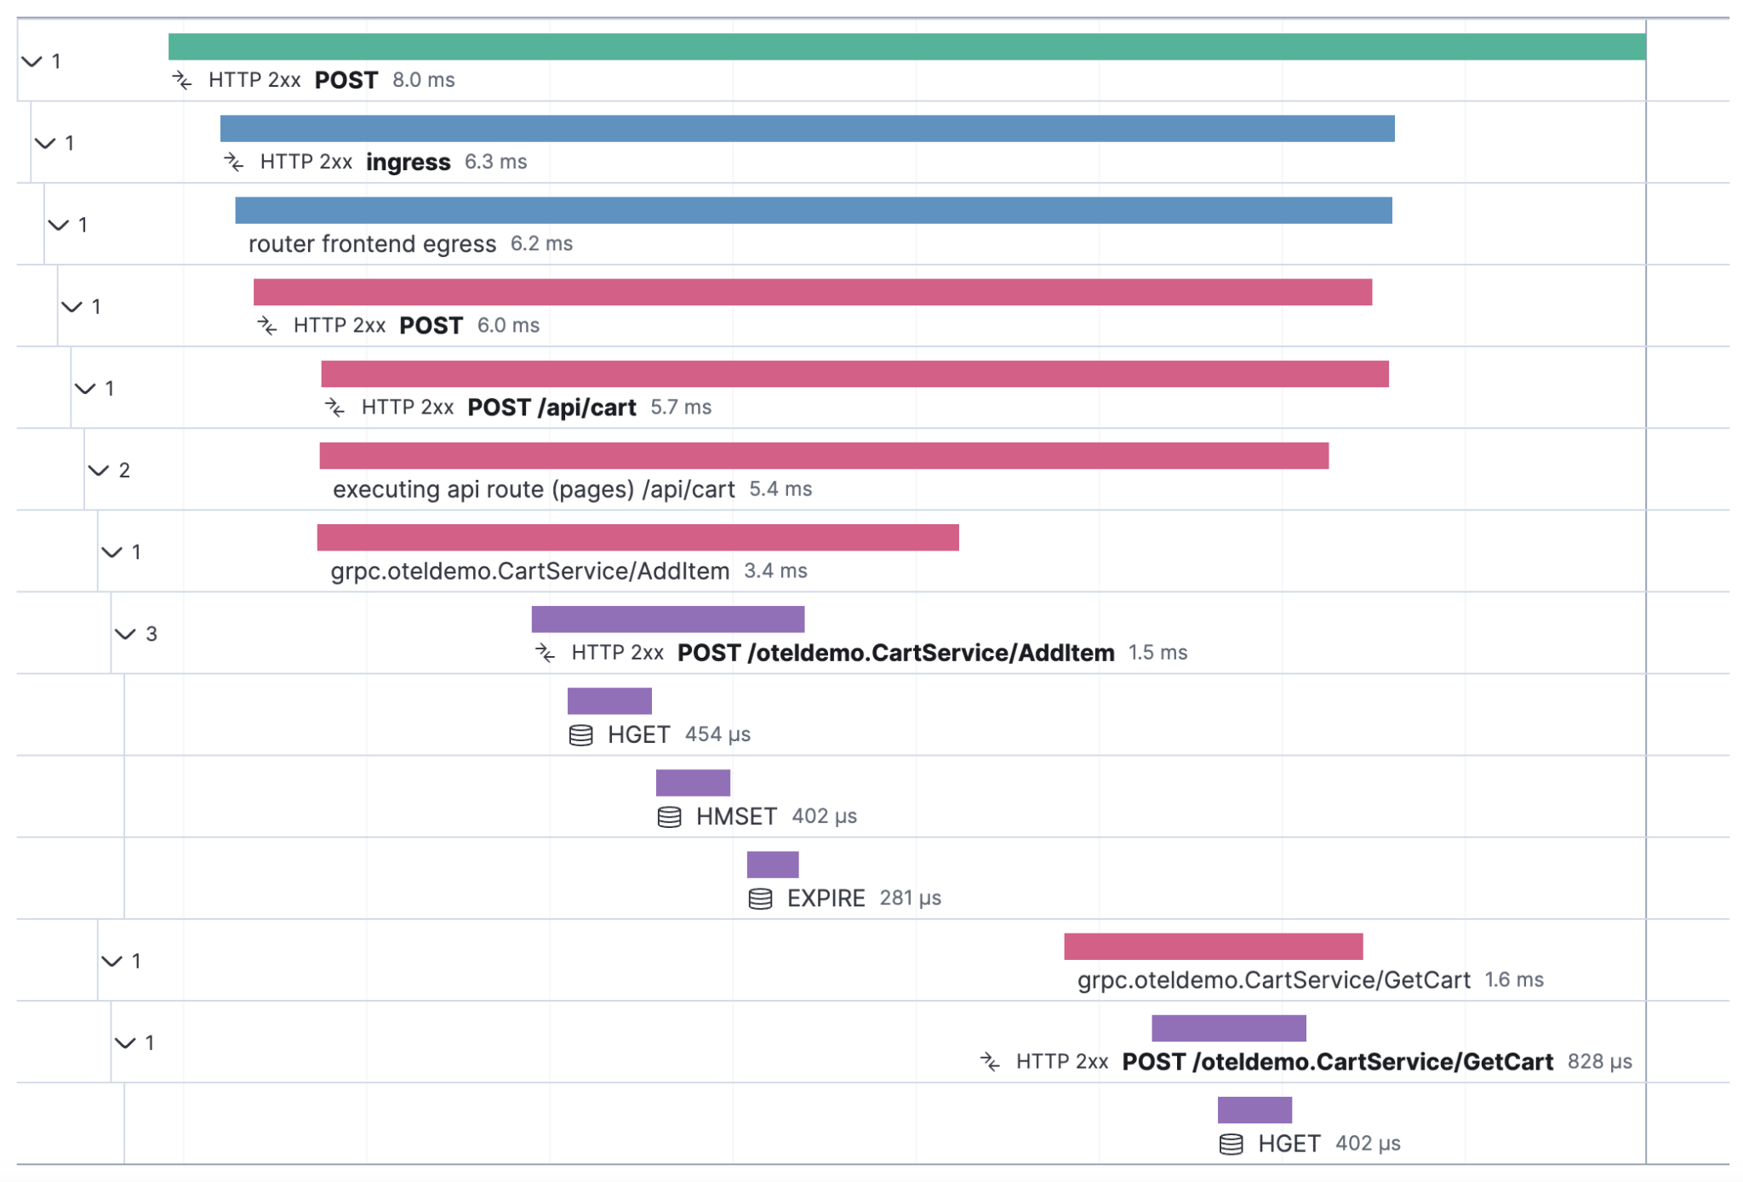

Slide 32
Concept
Instrumentation

Slide 33
Instrumenting refers to the process of adding observability features to your application to collect telemetry data, such as traces, metrics, and logs.

Slide 34
Two types of Instrumentation
Automatic
A wrapper is invoked before your application is started and the service monitors activity of the available libraries. Supported modules can be found at the Open Telemetry Registry
https://opentelemetry.io/ecosystem/registry/
Notes:
Frameworks supported: Express, Koa, Fastify,Hapi
Databases: MongoDB, MySQL, PostgreSQL, Redis
Messaging Systems, Kafka, RabbitMQ, NATS

Slide 35
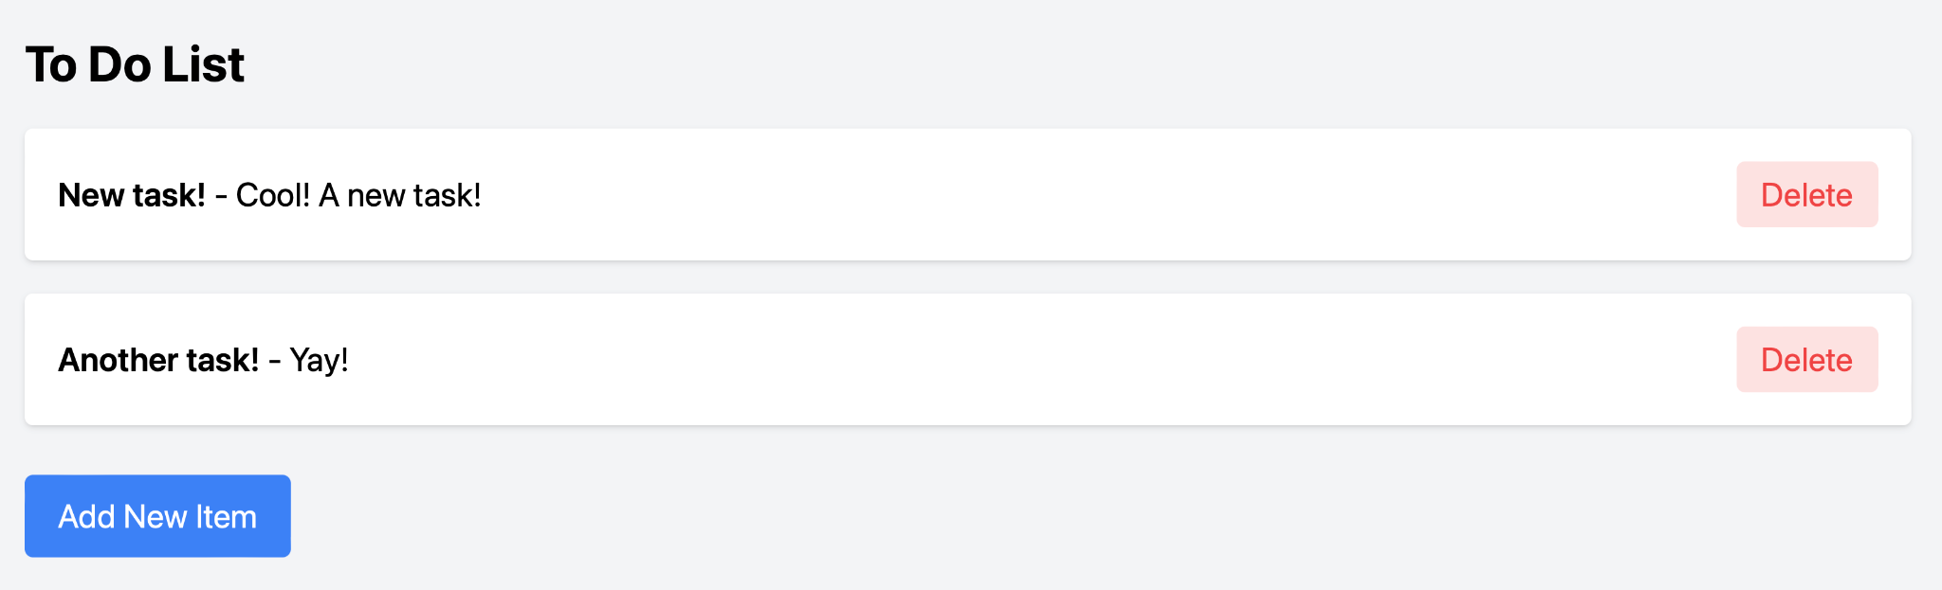
Node.js CRUD Example

Slide 36
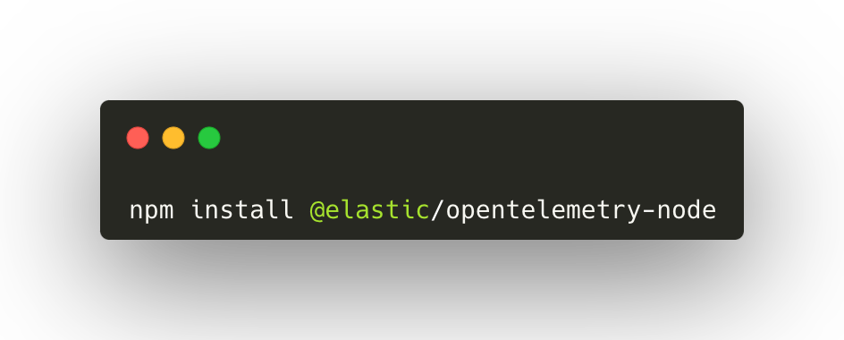
Automatic Instrumentation Example
Dependencies

Slide 37
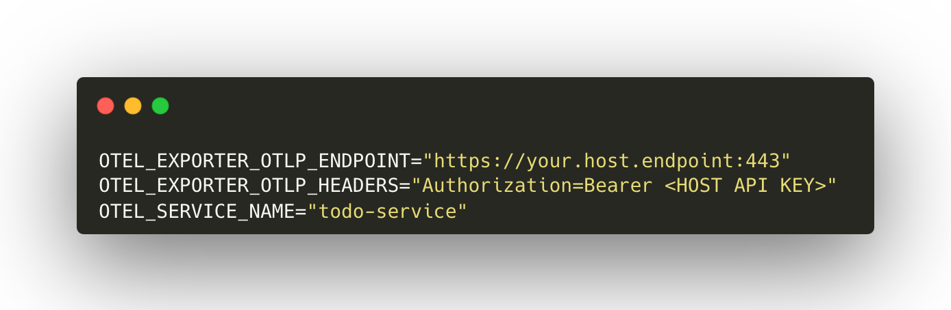
Automatic Instrumentation Example
Environment Variables

Slide 38
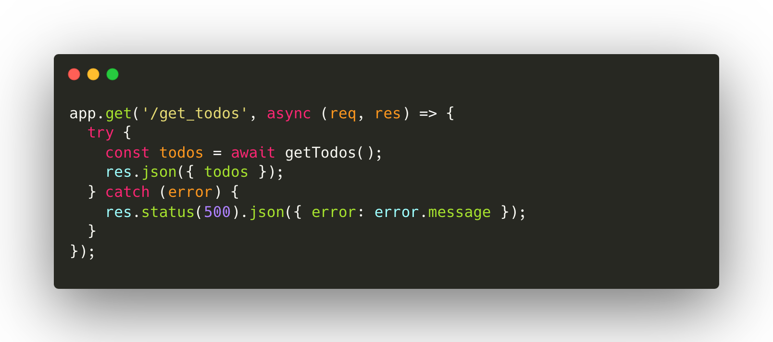
Automatic Instrumentation Example
Standard CRUD endpoints

Slide 39
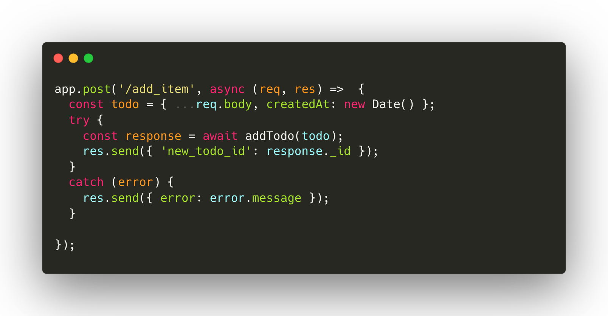
Automatic Instrumentation Example
Standard CRUD endpoints

Slide 40
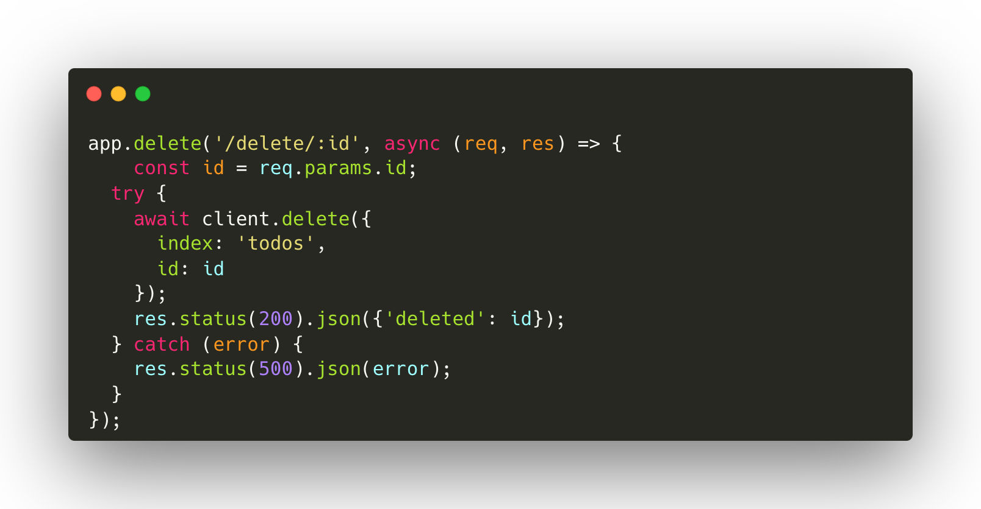
Automatic Instrumentation Example
Standard CRUD endpoints

Slide 41
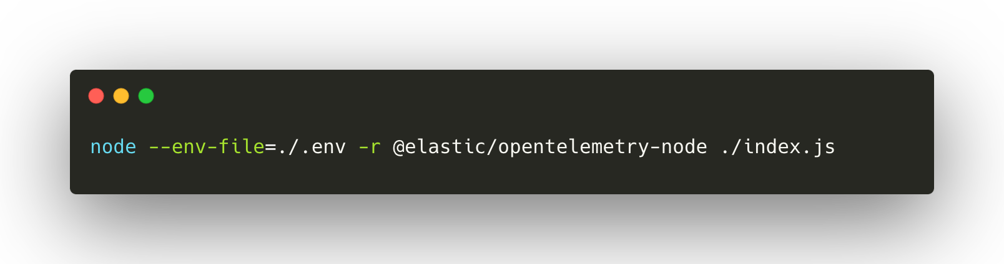
Automatic Instrumentation Example
Start your application with the OTel wrapper

Slide 42
Two types of Instrumentation
Manual
This instrumentation requires incorporating particular code segments into your application to collect and transmit telemetry data. Namely, a collector that receives trace, metrics, and logs and sends them via the Open Telemetry protocol to a specific destination.
Notes:
Frameworks supported: Express, Koa, Fastify,Hapi
Databases: MongoDB, MySQL, PostgreSQL, Redis
Messaging Systems, Kafka, RabbitMQ, NATS

Slide 43
So when would you want to use manual instrumentation?

Slide 44
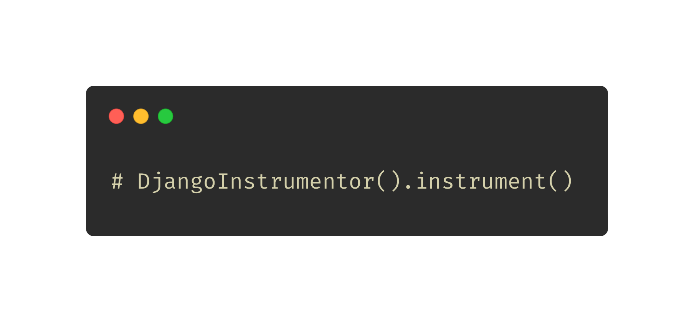
Step 1: Delete this line from your manage.py file

Slide 45
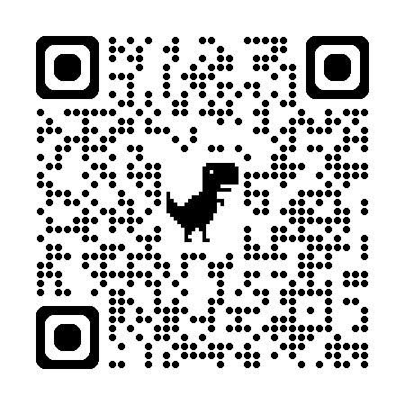
Manual Instrumentation Example
Open Telemetry E-Commerce Demo
https://github.com/elastic/opentelemetry-demo

Slide 46
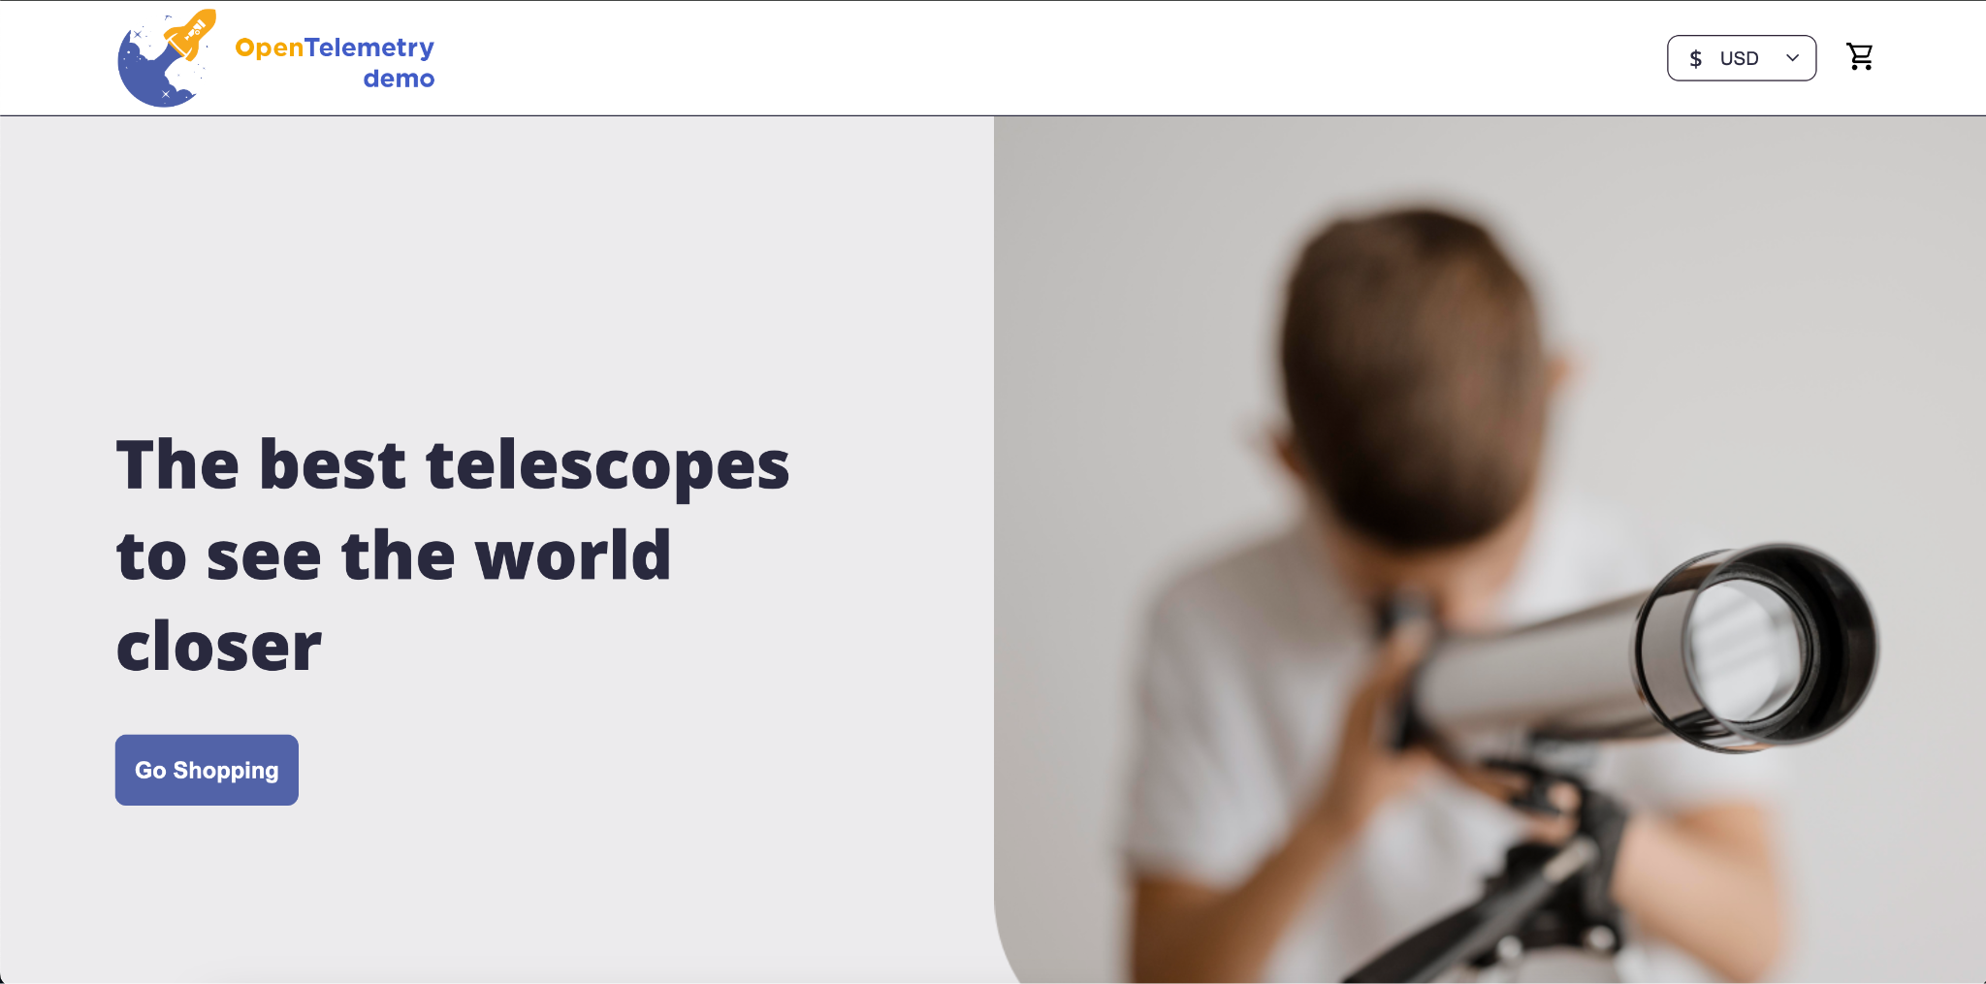
Manual Instrumentation Example
Open Telemetry Demo (Elastic Flavor)
Demonstration of OTel in a large microservice infrastructure
Support for various languages
Automatic and Manual Instrumentation
This fork uses Elastic connectors

Slide 47
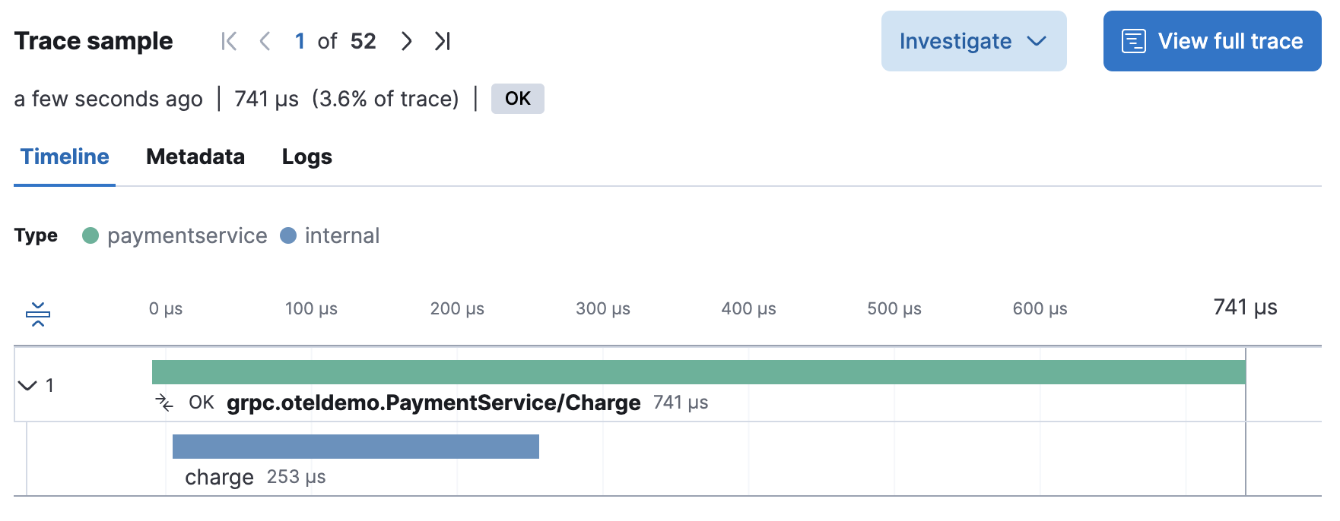
Manual Instrumentation Example
/paymentservice

Slide 48
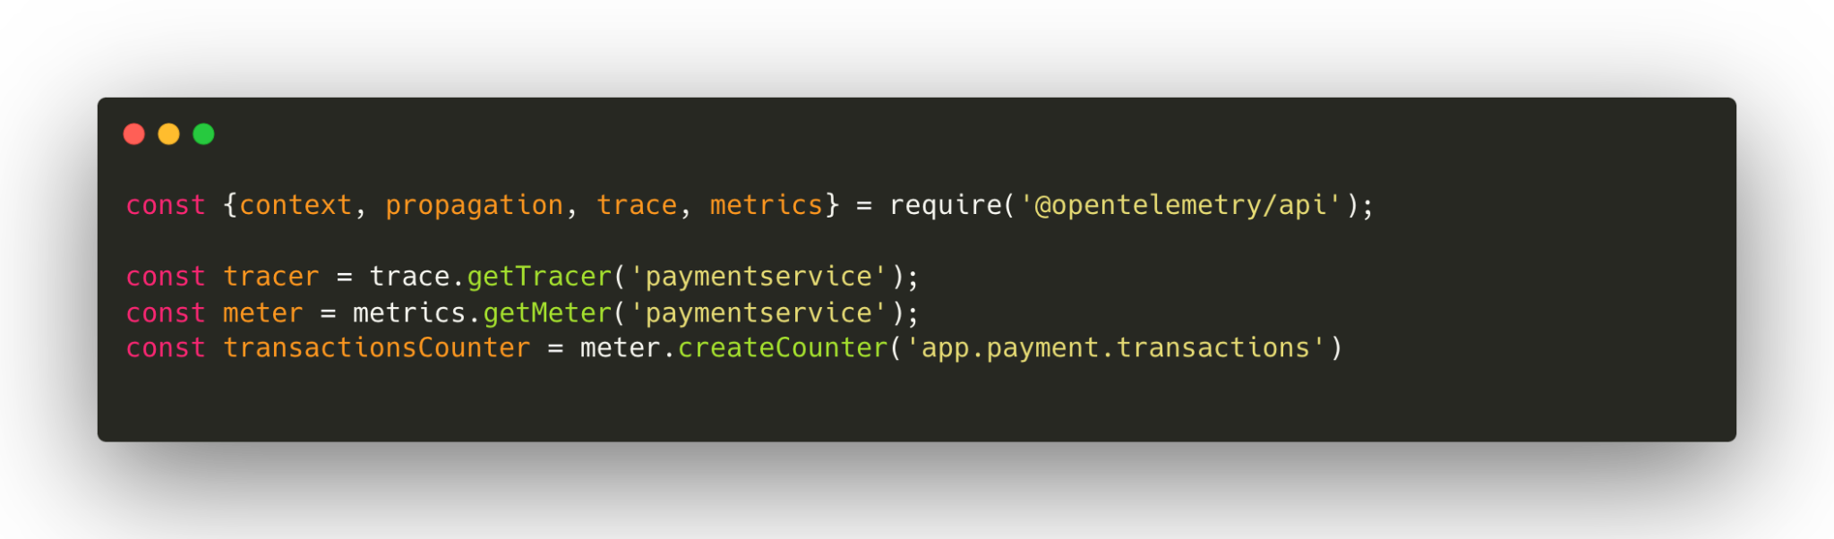
Manual Instrumentation Example
Initialization of modules - charge.js

Slide 49
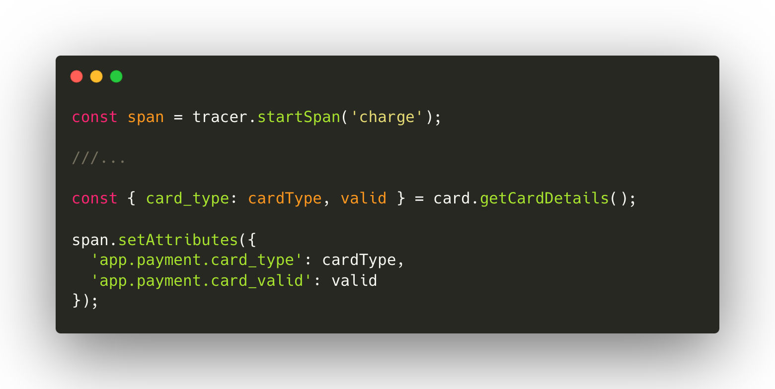
Manual Instrumentation Example
Creation of spans & setting attributes - charge.js

Slide 50
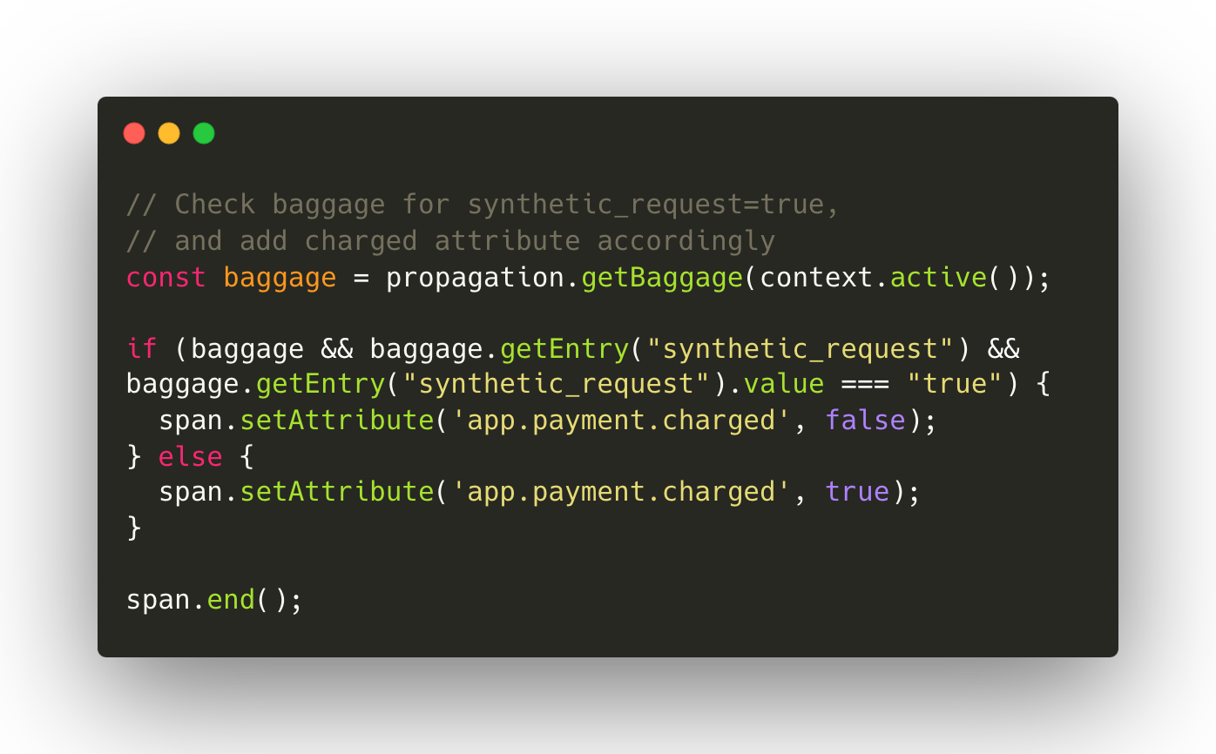
Manual Instrumentation Example
Synthetic monitoring & span termination - charge.js

Slide 51
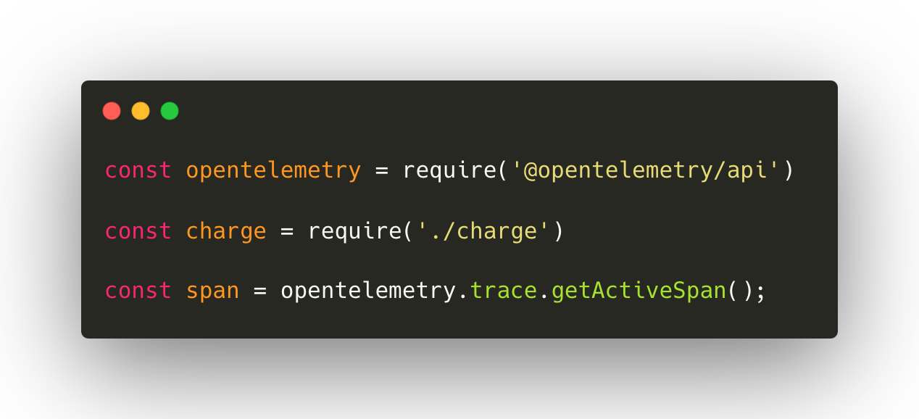
Manual Instrumentation Example
Initialization of modules - index.js

Slide 52
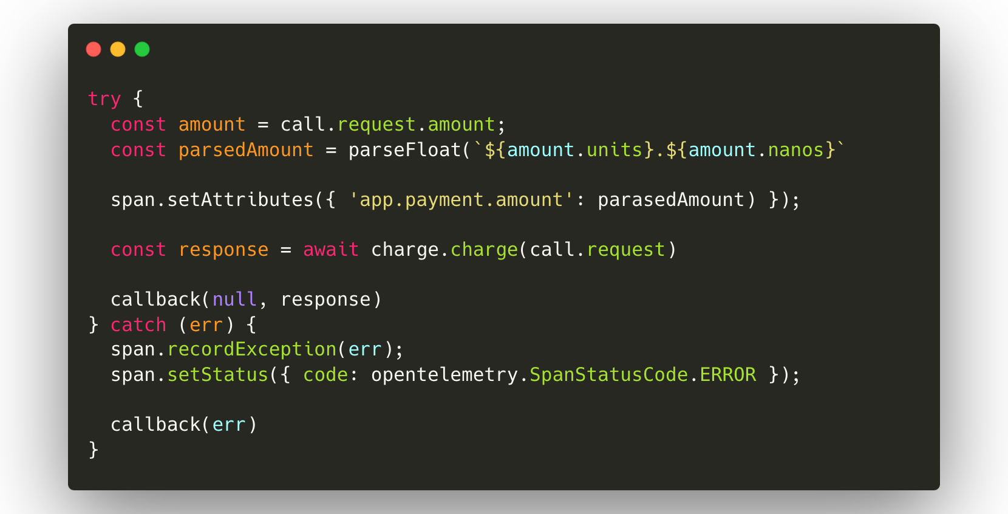
Manual Instrumentation Example
Execution of charge function - index.js

Slide 53

State of adoption
Notes:
Young project
“It’s getting better all the time”
Lots of features are experimental
Not all tools at this moment support all features of OTel

Slide 54
Status:
https://opentelemetry.io/status/
Registry of modules:
https://opentelemetry.io/ecosystem/registry/
Getting started (JS): https://opentelemetry.io/docs/languages/js/getting-started/

Slide 55
Takeaways

Slide 56
OpenTelemetry is an open-source, vendor-neutral observability framework designed to integrate with any backend system.

Slide 57
It's very easy to start instrumenting your code.

Slide 58
It is highly configurable and extensible
Notes:
OpenTelemetry is designed to be extensible. Some examples of how it can be extended include:
Adding a receiver to the OpenTelemetry Collector to support telemetry data from a custom source
Loading custom instrumentation libraries into an SDK
Creating a distribution of an SDK or the Collector tailored to a specific use case
Creating a new exporter for a custom backend that doesn’t yet support the OpenTelemetry protocol (OTLP)
Creating a custom propagator for a nonstandard context propagation format
Although most users might not need to extend OpenTelemetry, the project is designed to make it possible at nearly every level.

Slide 59
It scales well from small to large applications

Slide 60
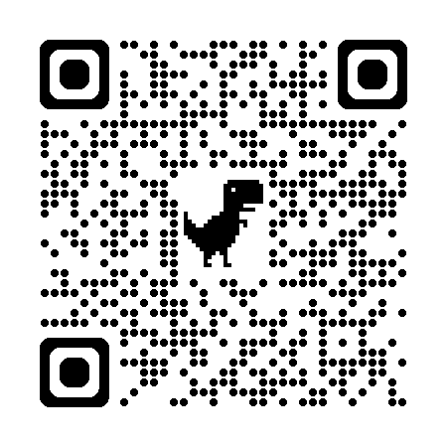
justin.castilla
@elastic.co
Slides & Demo
Thank you!

